Slide 1
Project 2
Emmanuel Hmar

Slide 2
File Manager
List the files and folder
Open file -> Let user choose which app to use
Write files to external storage, internal storage, or cache

Slide 3
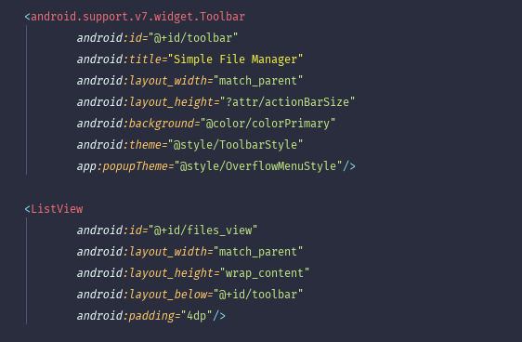
Overall Design
2 Activities, 3 Layout xml files
MainActivity: Toolbar, ListView
ListView Adapter: ImageView, TextView
Menu for “+” button
Write Files Activity: Toolbar, 2 EditTexts, 3 Buttons

Slide 4
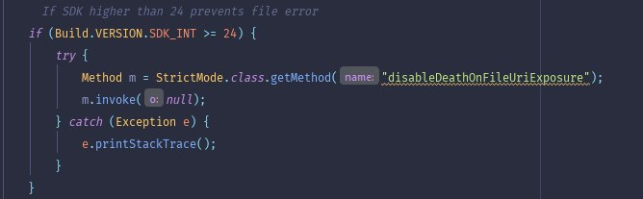
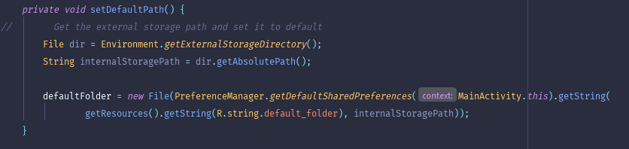
OS-related low-level functionalities
StrictMode – detects things you might be doing by accident. Keeping disk and network operation off the main thread makes for much smoother, more responsive applications.
Environment - Provides access to environment variables. getExternalStorageDirectory(), isexternalstoragemounted(), etc.
Mostly operated on java.io.File – file and directory pathnames.

Slide 5
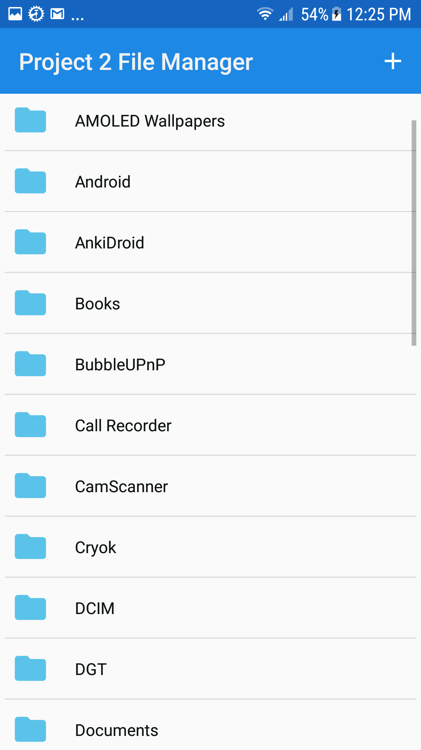
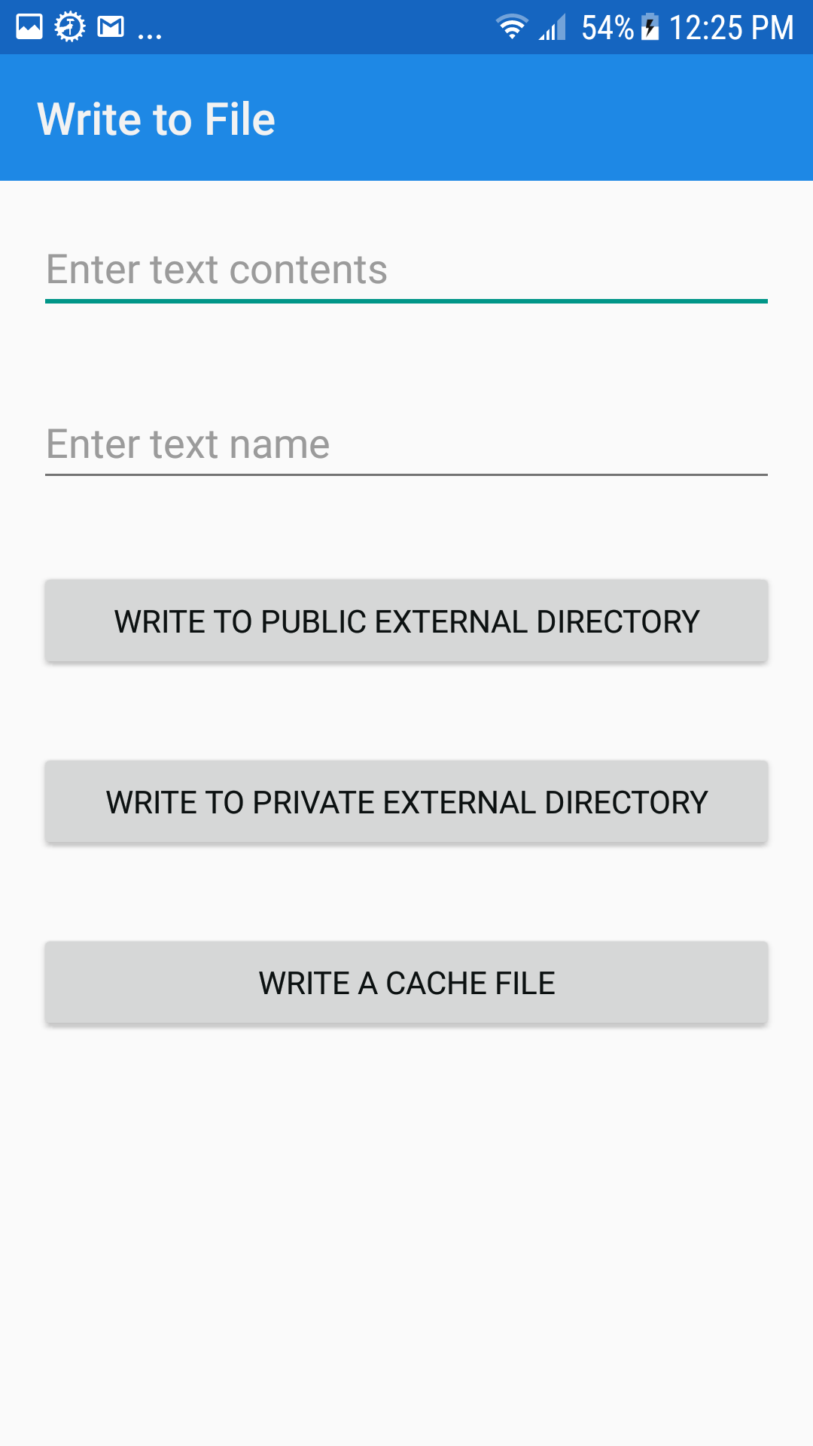
Project 2 File Manager

